Slide 1
System Testing

Slide 2
System Testing
System Testing means testing the system as a whole.
All the modules/components are integrated in order to verify if the system works as expected or not.
System Testing is done after Integration Testing.
The process of testing an integrated hardware and software system to verify that the system meets its specified requirements.

Slide 3
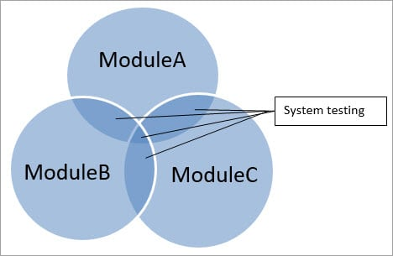
System Testing
If an application has three modules A, B, and C, then testing done by combining the modules A & B or module B & C or module A& C is known as Integration testing.
Integrating all the three modules and testing it as a complete system is termed as System testing.

Slide 4
System Testing Example
A car manufacturer does not produce the car as a whole car.
Each component of the car is manufactured separately, like seats, steering, mirror, break, cable, engine, car frame, wheels etc.
After manufacturing each item, it is tested independently whether it is working the way it is supposed to work and that is called Unit testing.
Now, when each part is assembled with another part, that assembled combination is checked if assembling has not produced any side effect to the functionality of each component and whether both components are working together as expected and that is called Integration testing.
Once all the parts are assembled and the car is ready, it is not ready actually.

Slide 5
System Testing Example
The whole car needs to be checked for different aspects as per the requirements defined like if car can be driven smoothly, breaks, gears, and other functionality working properly, car does not show any sign of tiredness after being driven for 2500 miles continuously, color of car is generally accepted and liked, car can be driven on any kind of roads like smooth and rough, sloppy and straight, etc and this whole effort of testing is called System Testing and it has nothing to do with integration testing.

Slide 6
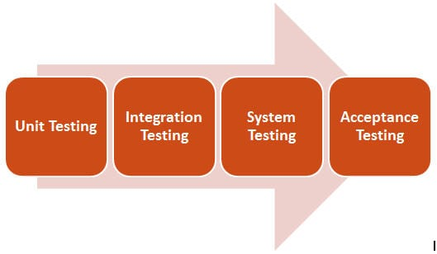
System Testing
It is performed when Integration Testing is completed.
It is mainly a Black-box type testing.
This testing evaluates the working of the system from a user point of view, with the help of a specification document.
It does not require any internal knowledge of systems like the design or structure of the code.
It contains functional and non-functional areas of application/product.

Slide 7
System Testing
It mainly focuses on the following:
External interfaces
Multiprogram and complex functionalities
Security
Recovery
Performance
Operator and user’s smooth interaction with the system
Installability
Documentation
Usability
Load/Stress

Slide 8
Why System Testing?
It is very important to complete a full test cycle and ST is the stage where it is done.
ST is performed in an environment that is similar to the production environment and hence stakeholders can get a good idea of the user’s reaction.
It helps to minimize after-deployment troubleshooting and support calls.
In this STLC stage Application Architecture and Business requirements, both are tested.

Slide 9
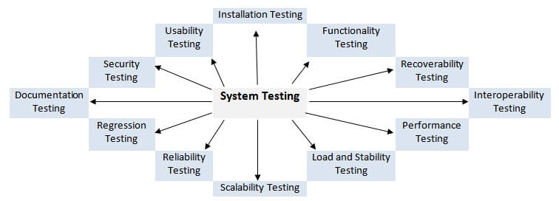
Types Of System Testing
ST is called a superset of all types of testing as all the major types of testing are covered in it. Although a focus on types of testing may vary on the basis of product, organization processes, timeline, and requirements.

Slide 10
Types of System Testing
End to End testing
verifying user actions can complete User Stories by fulfilling Acceptance Criteria
Performance testing
verifying the application is responsive withing contractual obligations
verifying the application has the scaling potential as planned
Load testing
verifying the application can handle the expected number of users
Compatibility Testing
verifying the application works in different environments
different browsers
different operating systems
Penetration Testing
verifying the security of the application is robust enough to withstands well known attacks

Slide 11
Typical Defects
Incorrect or unexpected functional behavior
System does not conform to specifications
Inability to complete all parts of end-to-end tasks
Performance does not meet minimal requirements
Application does not meet security requirements

Slide 12
Typical Functional Tests
simulating a user creating a new account following the Acceptance Criteria for the User Story associated with the action
Typical Non-Functional Tests
A test that confirms Every web page loads within the required amount of time
attempting to access sensitive data a typical user should not have access to

